Slide 1
Topic 7. Moving beyond Linearity

Slide 2
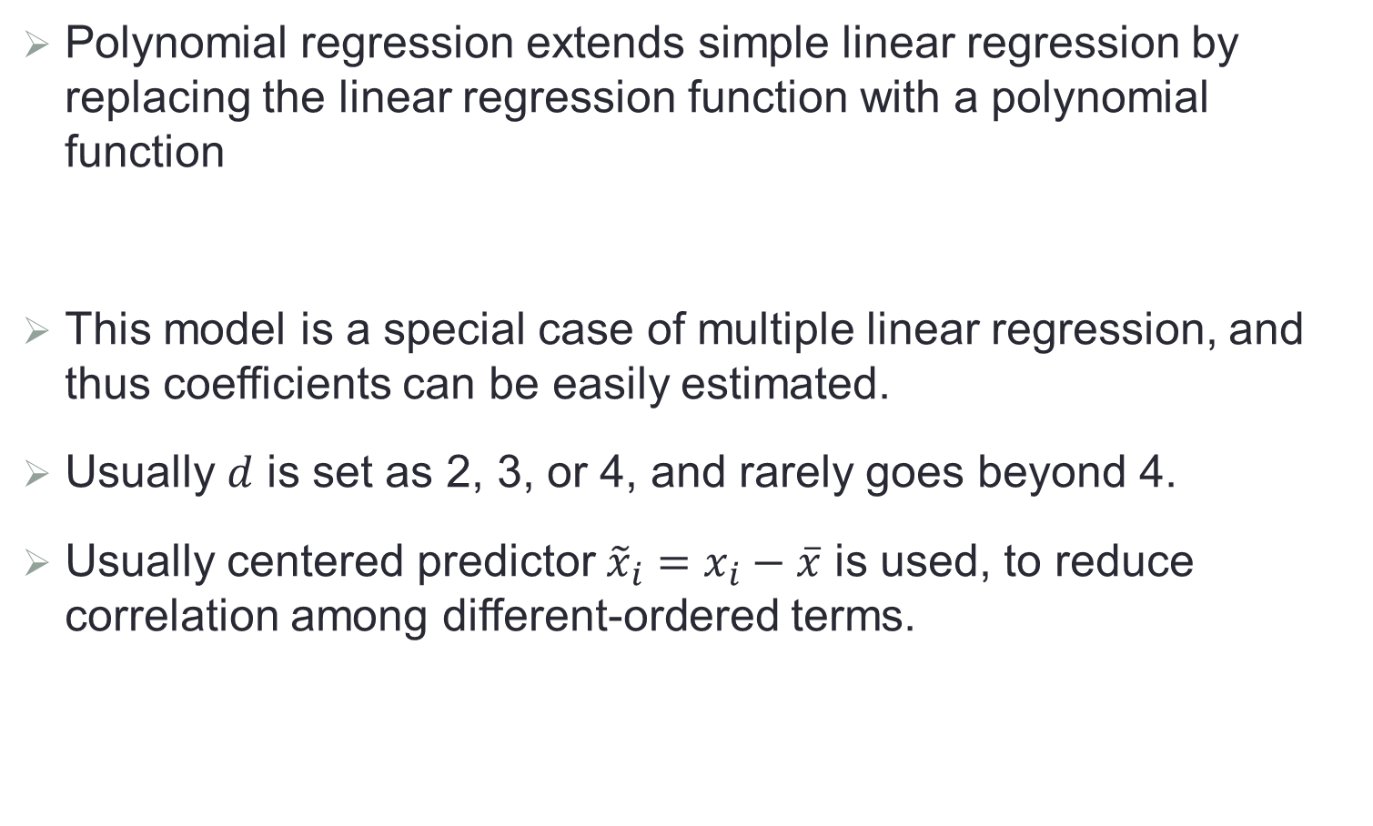
Polynomial Regression
Polynomial regression extends simple linear regression by replacing the linear regression function with a polynomial function
This model is a special case of multiple linear regression, and thus coefficients can be easily estimated.
Usually $d$ is set as 2, 3, or 4, and rarely goes beyond 4.
Usually centered predictor ${\tilde{x}}_{i}=x_{i}−\overline{x}$ is used, to reduce correlation among different-ordered terms.
$$y_{i}=β_{0}+β_{1}x_{i}+β_{2}x_{i}^{2}+…+β_{d}x_{i}^{d}+ε_{i}$$

Slide 3
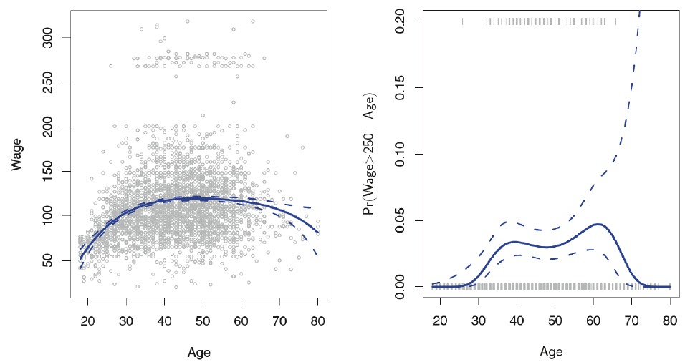
Examples with Degree-4 Polynomial Regression

Slide 4
Polynomial Logistic Regression
The left figure suggests that the wages are from two distinct populations.
Construct a binary response
High earners groups earning more than $250,000 per annum.
Low earners group otherwise.
Polynomial logistic regression assumes that
Coefficients can be estimated similarly.
$$logit\left(Pr\left(y_{i}>250|x_{i}\right)\right)=β_{0}+β_{1}x_{i}+β_{2}x_{i}^{2}+…+β_{d}x_{i}^{d}$$

Slide 5

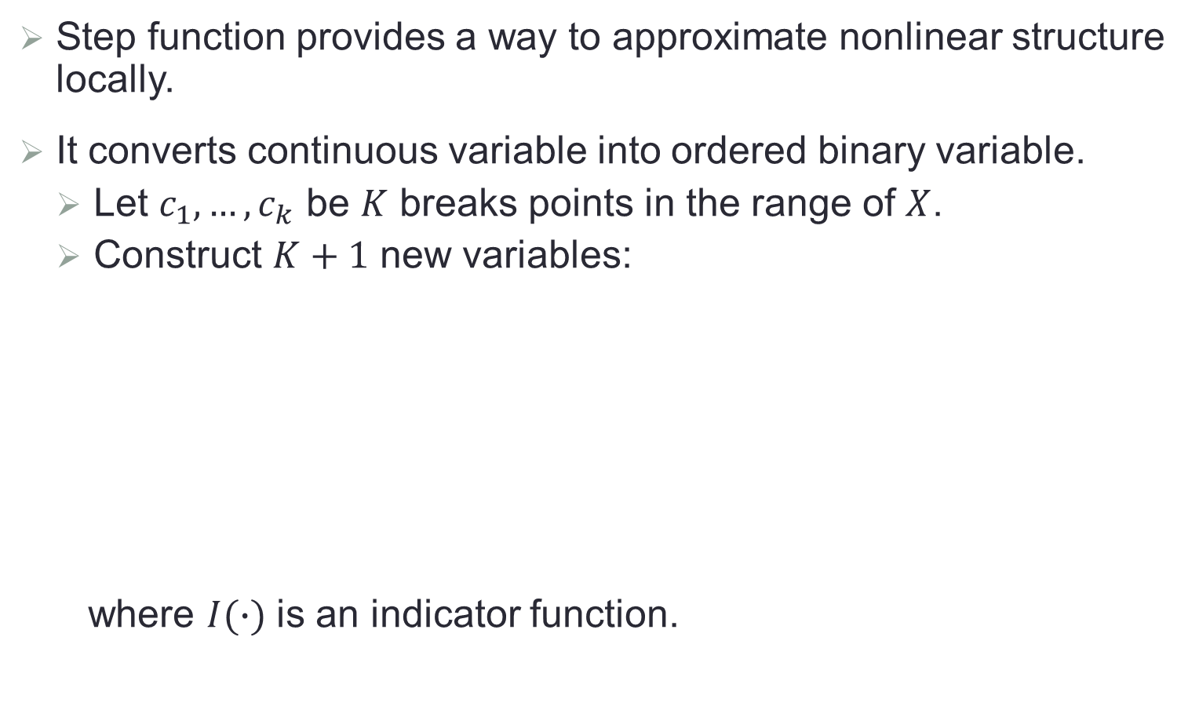


Step Functions
Step function provides a way to approximate nonlinear structure locally.
It converts continuous variable into ordered binary variable.
Let $c_{1},…,c_{k}$ be $K$ breaks points in the range of $X$.
Construct $K+1$ new variables:
where $I(∙)$ is an indicator function.
$$C_{0}\left(X\right)=I(X<c_{1})$$
$$C_{1}\left(X\right)=I(c_{1}≤X<c_{2})$$
…
$$C_{K}\left(X\right)=I(X≥c_{k})$$

Slide 6
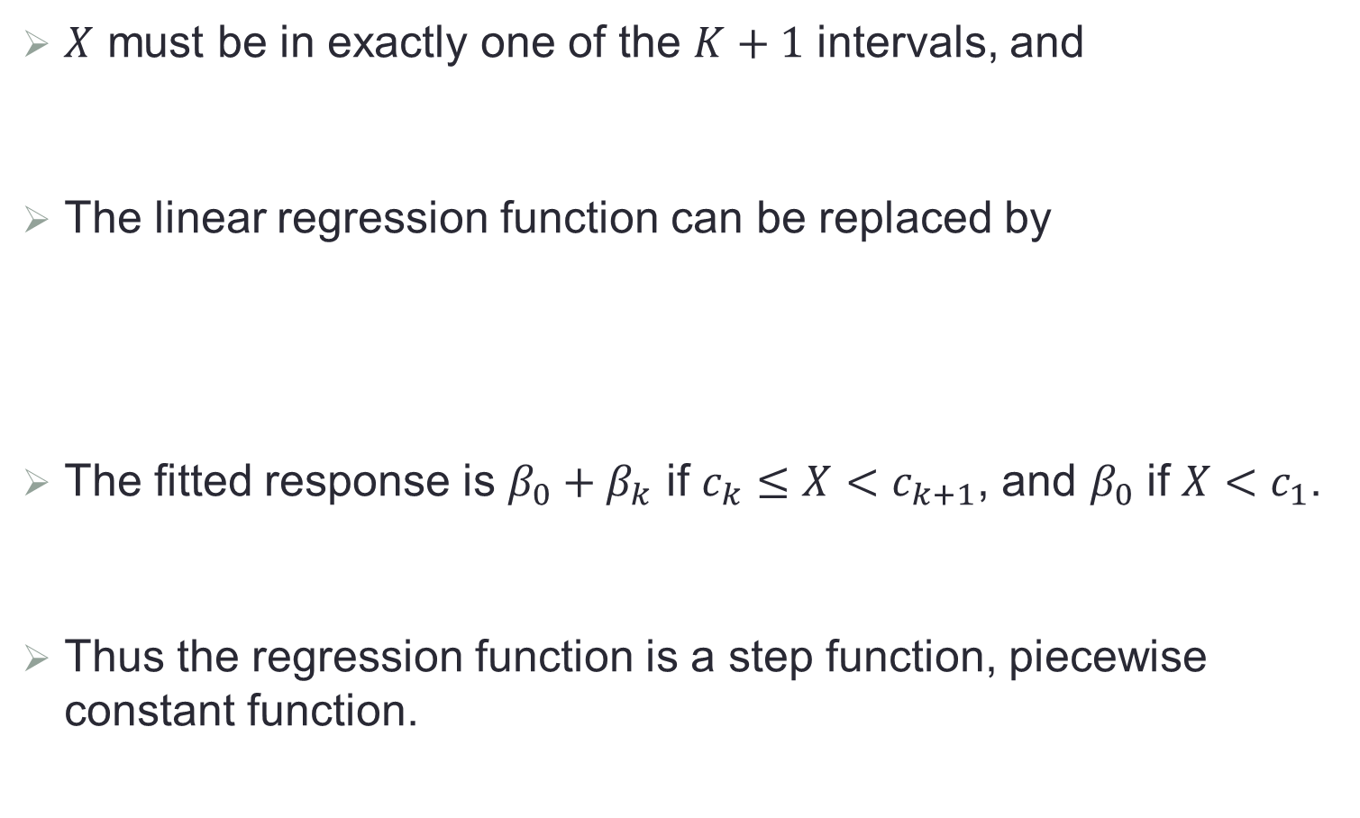
Step Functions
$X$ must be in exactly one of the $K+1$ intervals, and
The linear regression function can be replaced by
The fitted response is $β_{0}+β_{k}$ if $c_{k}≤X<c_{k+1}$, and $β_{0}$ if $X<c_{1}$.
Thus the regression function is a step function, piecewise constant function.
$$C_{0}\left(X\right)+C_{1}\left(X\right)+C_{2}\left(X\right)+…+C_{K}\left(X\right)=1$$
$$y_{i}=β_{0}+β_{1}C_{1}\left(X_{i}\right)+β_{2}C_{2}\left(X_{i}\right)+…+β_{K}C_{K}\left(X_{i}\right)+ε_{i}$$

Slide 7
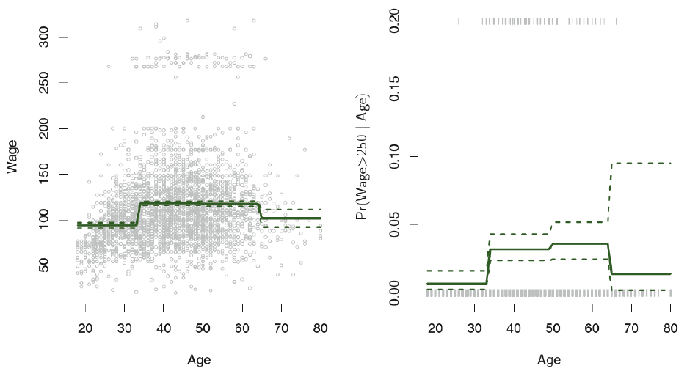
Example of Step Functions

Slide 8

Interaction Regression Model
When there are more than one predictors in the model, we can consider their interactions, e.g.,
The mean response change per unit change in each variable now depends on the other variables.
$$y_{i}=β_{0}+β_{1}x_{i1}+β_{2}x_{i2}+β_{12}x_{i1}x_{i2}+ε_{i}$$

Slide 9
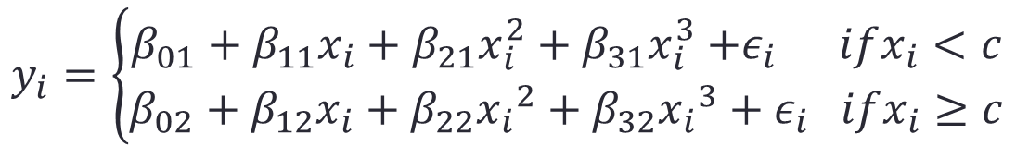
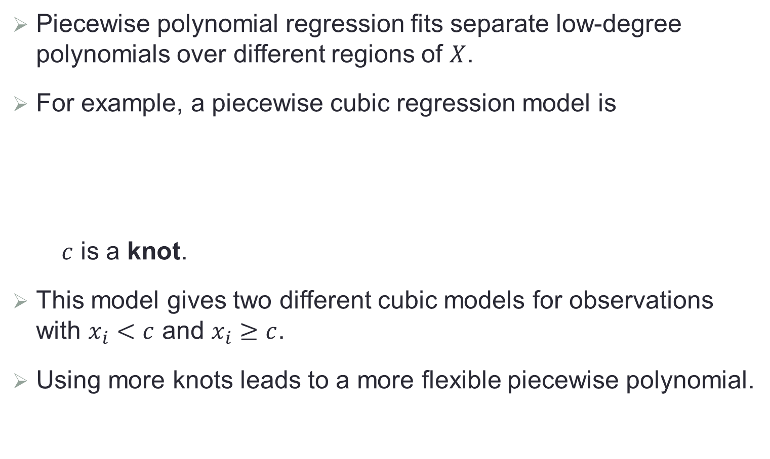
Piecewise Polynomials
Piecewise polynomial regression fits separate low-degree polynomials over different regions of $X$.
For example, a piecewise cubic regression model is
$c$ is a knot.
This model gives two different cubic models for observations with $x_{i}<c$ and $x_{i}≥c$.
Using more knots leads to a more flexible piecewise polynomial.
$$y_{i}=\left\{\begin{matrix}β_{01}+β_{11}x_{i}+β_{21}x_{i}^{2}+β_{31}x_{i}^{3}{+ε}_{i} ifx_{i}<c \\ {{β_{02}+β_{12}x_{i}+β}_{22}{x_{i}}^{2}+β_{32}{x_{i}}^{3}+ε}_{i} ifx_{i}≥c\end{matrix}\right.$$

Slide 10
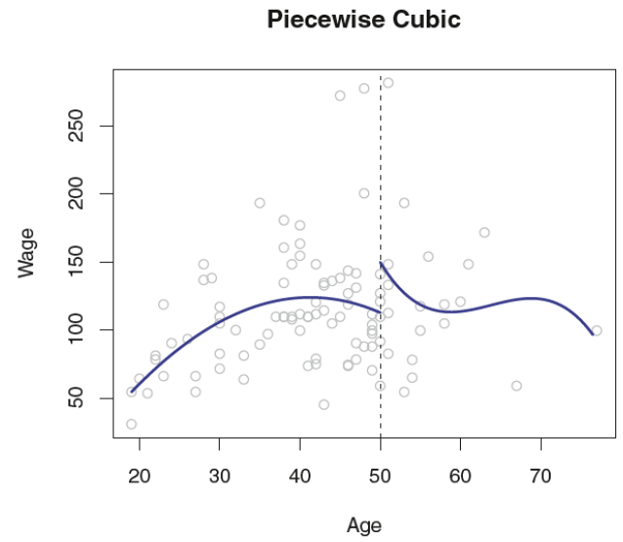
Example of Piecewise Cubic

Slide 11
Continuous Piecewise Polynomials
The fitted curve in last figure is “problematic”: the predicted wages jump at age 50!
One can fit a piecewise polynomial with the constraint that the fitted curve must be continuous.
In addition, one also require the derivatives of the piecewise polynomials are continuous.

Slide 12
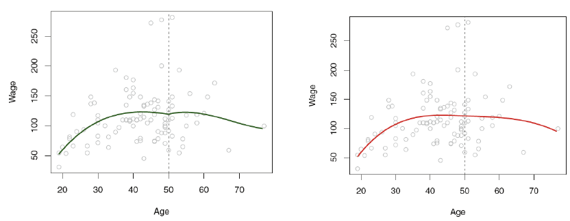
Continuous Piecewise Polynomials (Cont.)
Left: Continuous piecewise polynomials; Right: Piecewise polynomials with continuous first and second order derivatives (cubic spline)

Slide 13
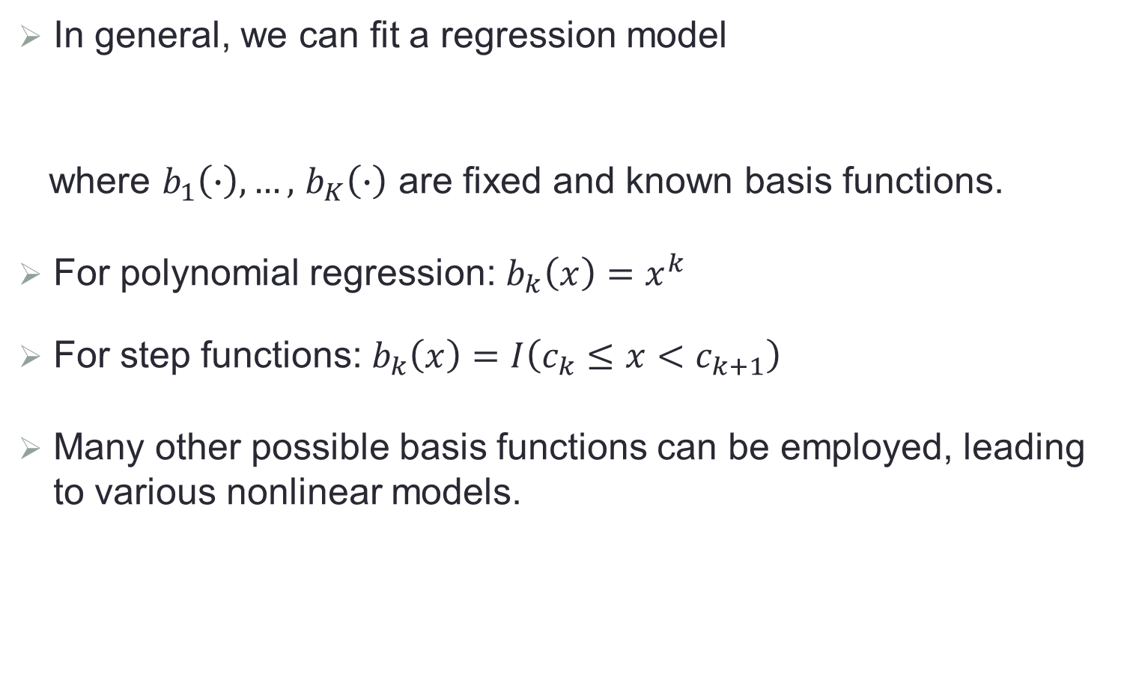
Basis Functions
In general, we can fit a regression model
where $b_{1}\left(∙\right),…,$ $b_{K}\left(∙\right)$ are fixed and known basis functions.
For polynomial regression: $b_{k}\left(x\right)=x^{k}$
For step functions: $b_{k}\left(x\right)=I\left(c_{k}≤x<c_{k+1}\right)$
Many other possible basis functions can be employed, leading to various nonlinear models.
$$y_{i}=β_{0}+β_{1}{b_{1}(x}_{i})+β_{2}{b_{2}(x}_{i})+…+β_{K}b_{K}(x_{i})+ε_{i}$$

Slide 14
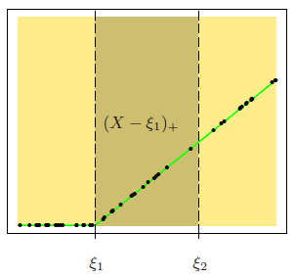
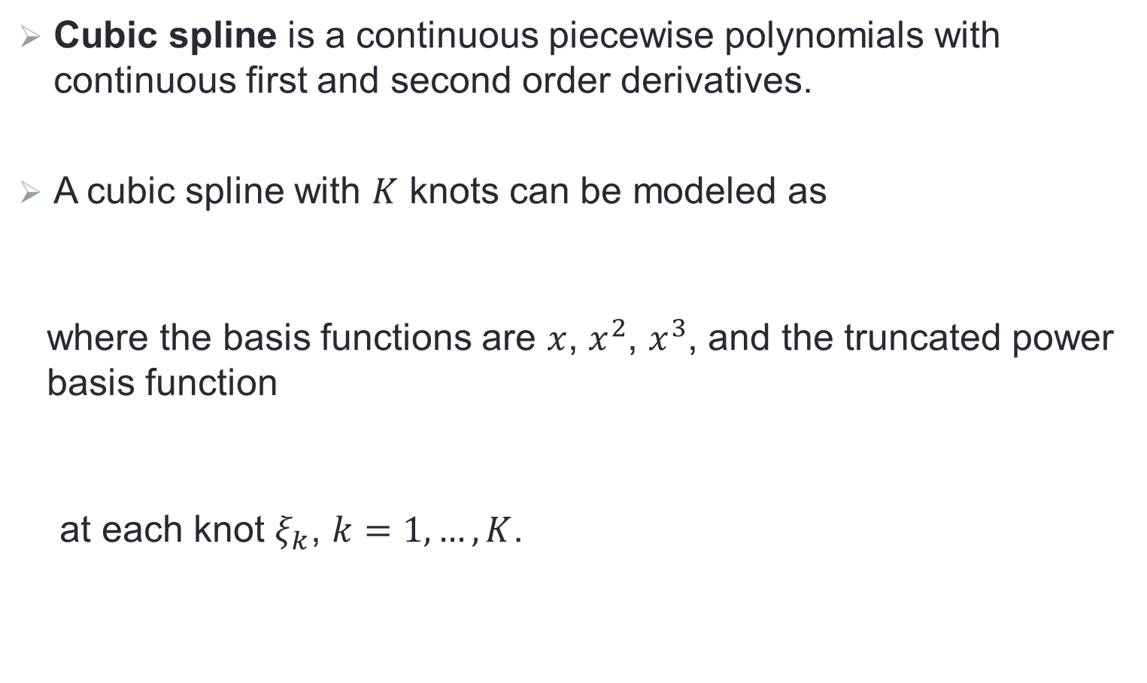
Cubic Spline
Cubic spline is a continuous piecewise polynomials with continuous first and second order derivatives.
A cubic spline with $K$ knots can be modeled as
where the basis functions are $x$, $x^{2}$, $x^{3}$, and the truncated power basis function
at each knot $ξ_{k}$, $k=1,…,K$.
$$y_{i}=β_{0}+β_{1}{b_{1}(x}_{i})+β_{2}{b_{2}(x}_{i})+…+β_{K+3}b_{K+3}(x_{i})+ε_{i}$$
$$h\left(x,ξ_{k}\right)={\left(x−ξ_{k}\right)}_{+}^{3}=max\left({\left(x−ξ_{k}\right)}^{3},0\right)$$

Slide 15
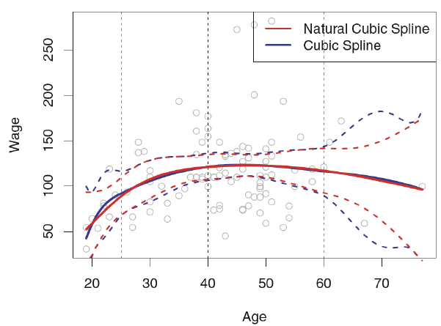
Cubic Spline (Cont.)
Splines can have high variance at the outer range of the predictors.
Natural spline is a regression spline requiring the model to be linear at the boundary. With this additional constraint, it generally produces more stable estimates at the boundaries.

Slide 16
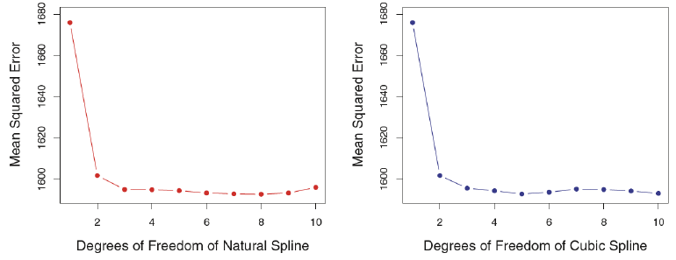
Determining Knots
Knots can be placed in a uniform fashion, say the knots in last figure are the 25th, 50th and 75th percentiles of Age.
Sophisticated ways of placing knots are also available.
The number of knots affects the complexity (degree of freedom) of the fitted model, and can be chosen via cross validation.

Slide 17
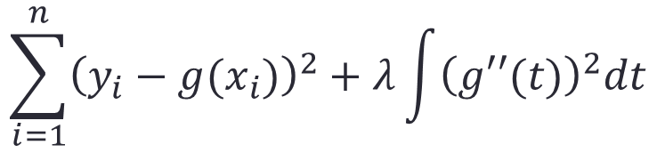
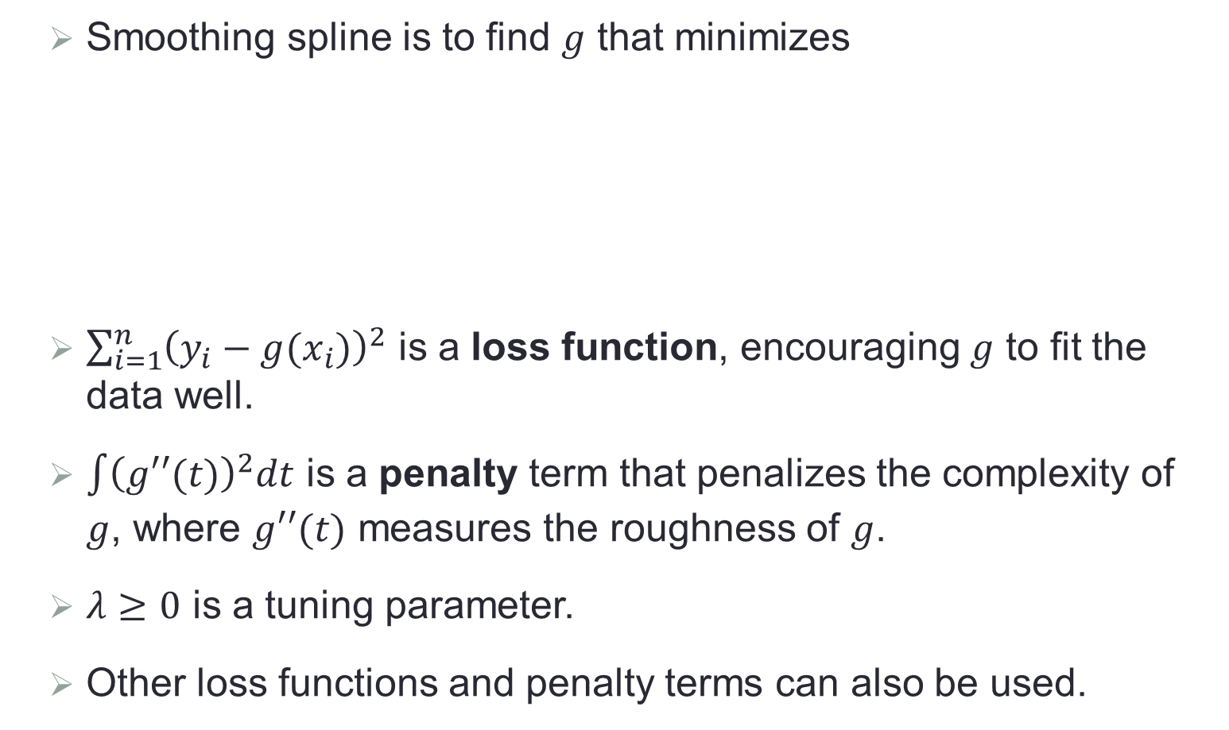
Smoothing Spline
Smoothing spline is to find $g$ that minimizes
$\sum_{i=1}^{n}{{\left(y_{i}−g(x_{i})\right)}^{2}}$ is a loss function, encouraging $g$ to fit the data well.
$\int{{\left(g′′(t)\right)}^{2}dt}$ is a penalty term that penalizes the complexity of $g$, where $g′′(t)$ measures the roughness of $g$.
$λ≥0$ is a tuning parameter.
Other loss functions and penalty terms can also be used.
$$\sum_{i=1}^{n}{{\left(y_{i}−g(x_{i})\right)}^{2}+λ\int{{\left(g′′(t)\right)}^{2}dt}}$$

Slide 18
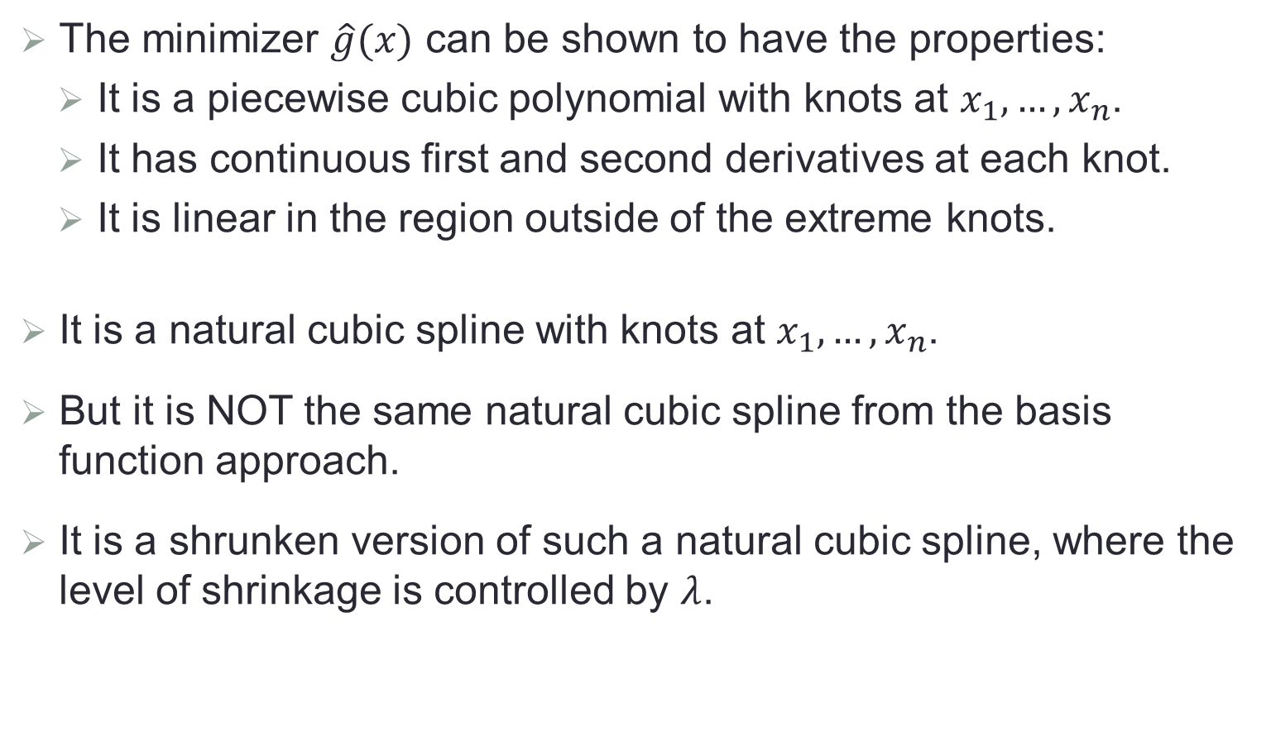
Smoothing Spline (Cont.)
The minimizer $\hat{g}(x)$ can be shown to have the properties:
It is a piecewise cubic polynomial with knots at $x_{1},…,x_{n}$.
It has continuous first and second derivatives at each knot.
It is linear in the region outside of the extreme knots.
It is a natural cubic spline with knots at $x_{1},…,x_{n}$.
But it is NOT the same natural cubic spline from the basis function approach.
It is a shrunken version of such a natural cubic spline, where the level of shrinkage is controlled by $λ$.

Slide 19
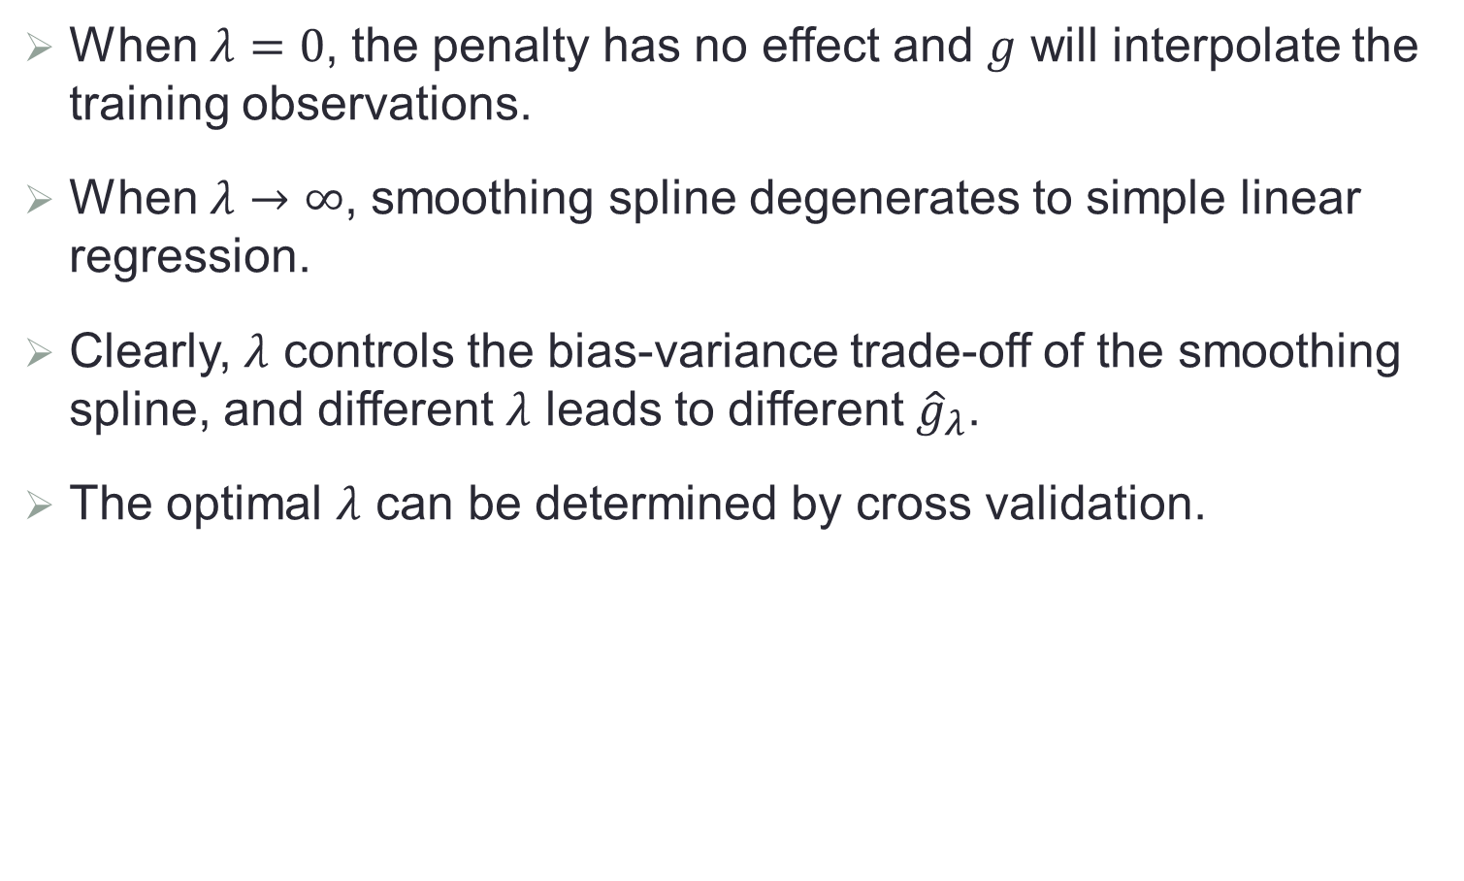
Tuning Parameter
When $λ=0$, the penalty has no effect and $g$ will interpolate the training observations.
When $λ→∞$, smoothing spline degenerates to simple linear regression.
Clearly, $λ$ controls the bias-variance trade-off of the smoothing spline, and different $λ$ leads to different ${\hat{g}}_{λ}$.
The optimal $λ$ can be determined by cross validation.

Slide 20
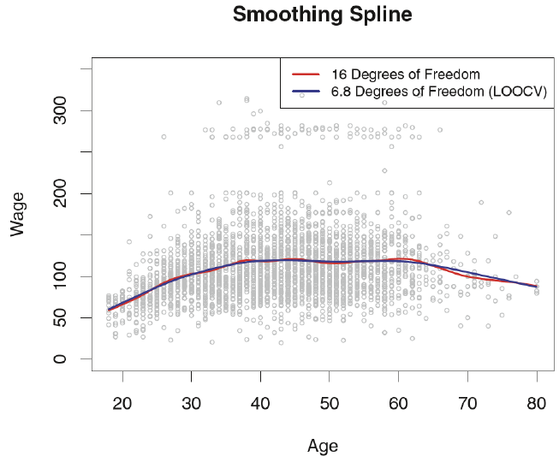
Example of Smoothing Spline

Slide 21
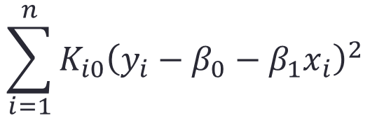
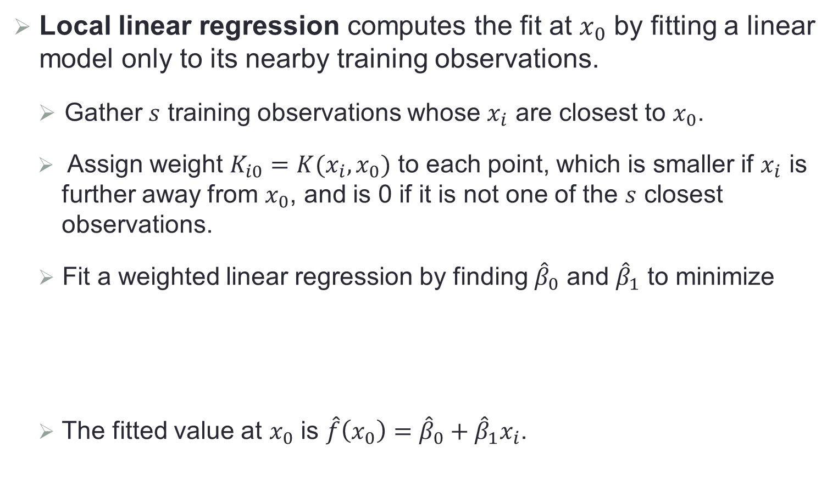
Local Linear Regression
Local linear regression computes the fit at $x_{0}$ by fitting a linear model only to its nearby training observations.
Gather $s$ training observations whose $x_{i}$ are closest to $x_{0}$.
Assign weight $K_{i0}=K(x_{i},x_{0})$ to each point, which is smaller if $x_{i}$ is further away from $x_{0}$, and is 0 if it is not one of the $s$ closest observations.
Fit a weighted linear regression by finding ${\hat{β}}_{0}$ and ${\hat{β}}_{1}$ to minimize
The fitted value at $x_{0}$ is $\hat{f}\left(x_{0}\right)={\hat{β}}_{0}+{\hat{β}}_{1}x_{i}$.
$$\sum_{i=1}^{n}{K_{i0}{\left(y_{i}−β_{0}−β_{1}x_{i}\right)}^{2}}$$

Slide 22
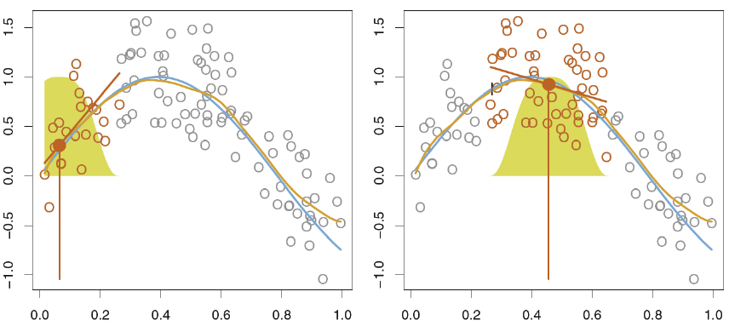
Local Linear Regression

Slide 23
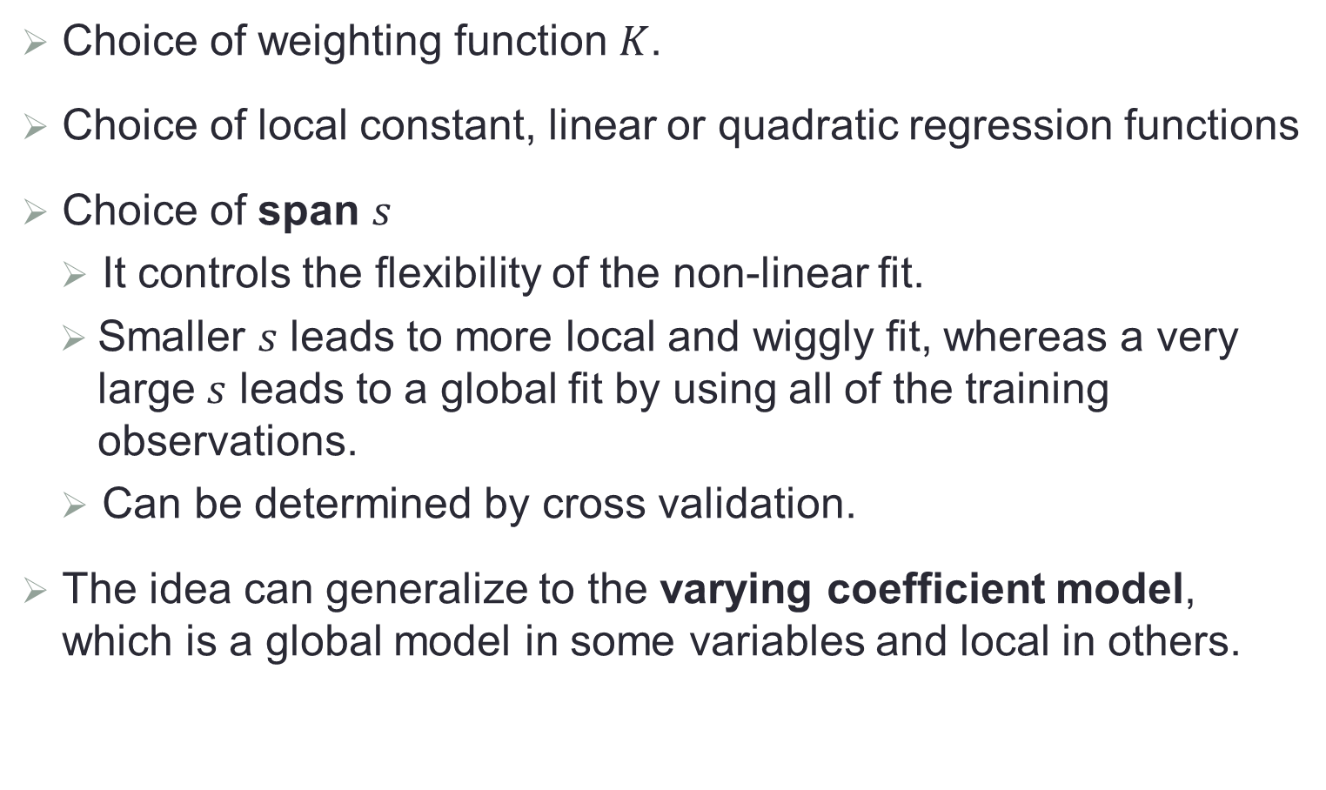
Some Remarks
Choice of weighting function $K$.
Choice of local constant, linear or quadratic regression functions
Choice of span $s$
It controls the flexibility of the non-linear fit.
Smaller $s$ leads to more local and wiggly fit, whereas a very large $s$ leads to a global fit by using all of the training observations.
Can be determined by cross validation.
The idea can generalize to the varying coefficient model, which is a global model in some variables and local in others.

Slide 24
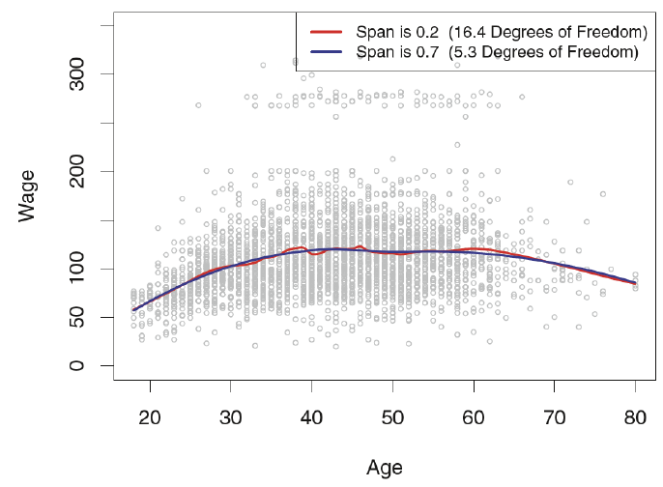
Example with Local Regression

Slide 25
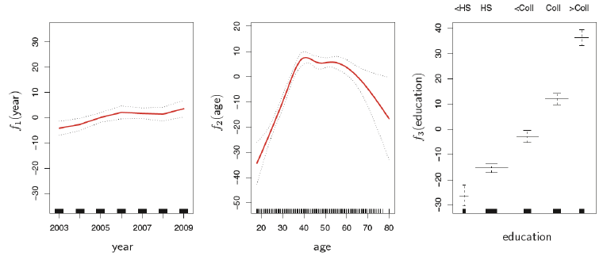
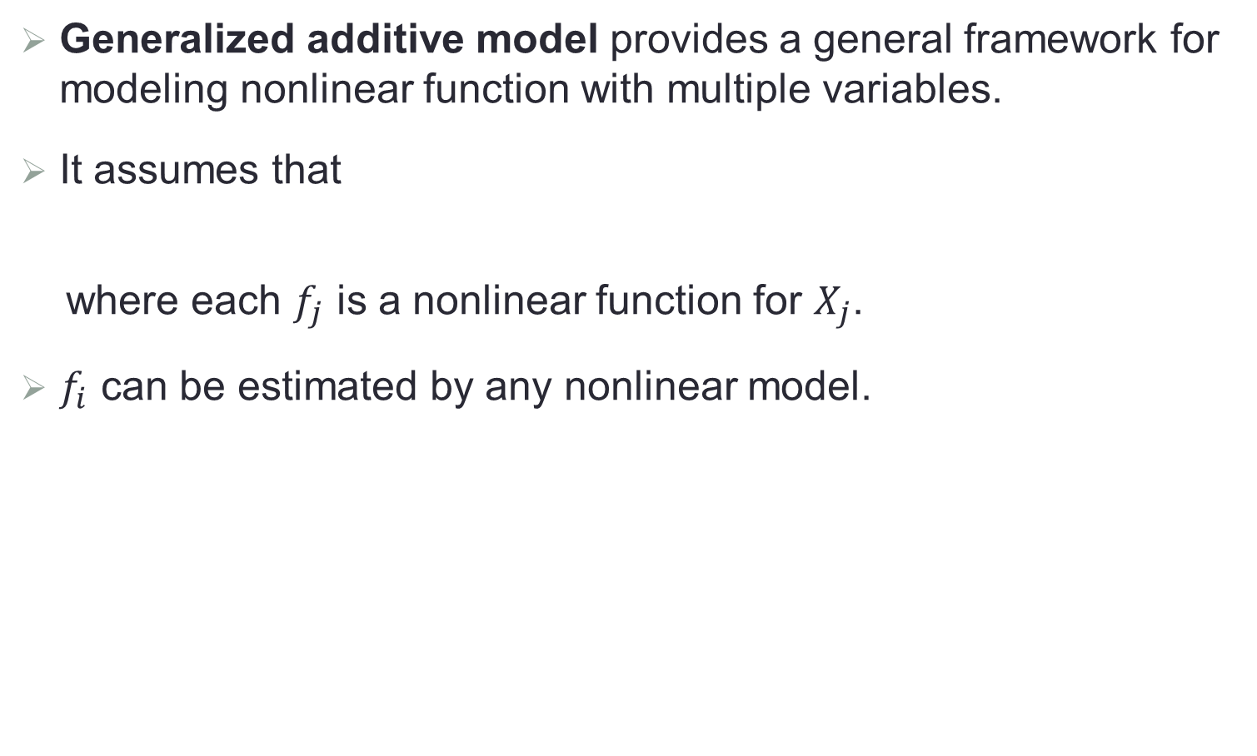
Generalized Additive Model (GAMs)
Generalized additive model provides a general framework for modeling nonlinear function with multiple variables.
It assumes that
where each $f_{j}$ is a nonlinear function for $X_{j}$.
$f_{i}$ can be estimated by any nonlinear model.
$$y_{i}=β_{0}+f_{1}\left(x_{i1}\right)+…+f_{p}\left(x_{ip}\right)+ε_{i}$$

Slide 26
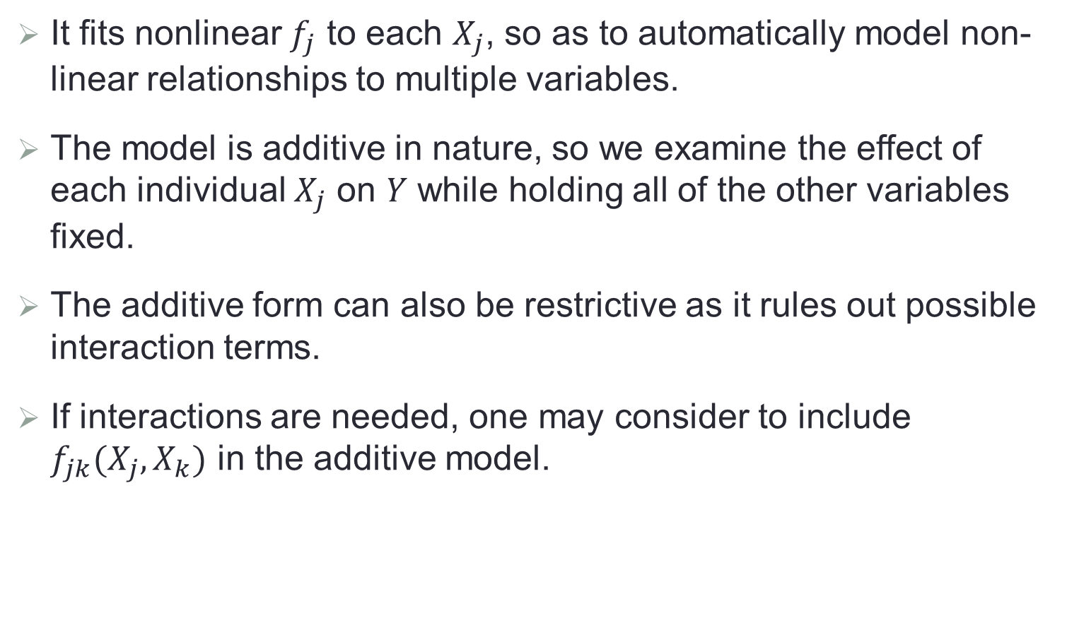
Pros and Cons
It fits nonlinear $f_{j}$ to each $X_{j}$, so as to automatically model non-linear relationships to multiple variables.
The model is additive in nature, so we examine the effect of each individual $X_{j}$ on $Y$ while holding all of the other variables fixed.
The additive form can also be restrictive as it rules out possible interaction terms.
If interactions are needed, one may consider to include $f_{jk}(X_{j},X_{k})$ in the additive model.

